Slide 1

Introduction to Deno
A secure runtime for JavaScript and TypeScript.

Slide 2
What is it?
From the website: Deno is a simple, modern and secure runtime for JavaScript and TypeScript that uses V8 and is built in Rust.
Secure by default. No file, network, or environment access, unless explicitly enabled.
Supports TypeScript out of the box.
Ships only a single executable file.
Has built-in utilities like a dependency inspector (deno info) and a code formatter (deno fmt).
Has a set of reviewed (audited) standard modules that are guaranteed to work with Deno: deno.land/std

Slide 3
Why do we care?
Sounds like nodejs? Same person who created nodejs created deno!
Both Javascript and Typescript can be used outside of the browser. No need to transpile, deno works with typescript.
Deno has a standard library.
Deno can use web assembly.
No package.jsons needed! (most controversial change but more later)

Slide 4
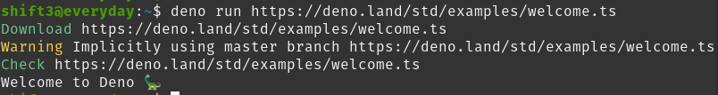
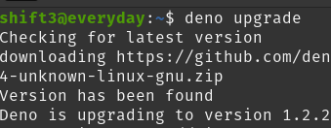
Getting Started - Install and Example

Slide 5
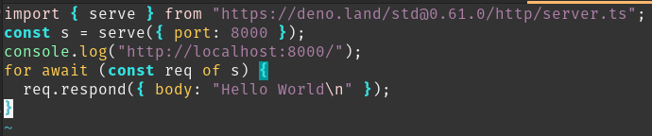

Getting Started - Part 2 (Simple web server)

Slide 6
Getting Started - Part 3 (More complicated)
Other example programs (all based on https://deno.land/manual):
Making an HTTP request
Reading Files
TCP server
An implementation of the unix "cat" program
File server
TCP echo server
Run subprocess
Inspecting and revoking permissions
Handle OS Signals
File system events

Slide 7


Example REST API
How to build a RESTFUL API with deno?
Deno (duh)
OAK: A middleware framework for Deno's net server
PostgreSQL: The World's Most Advanced Open Source Relational Database
+
+

Slide 8
WebAssembly
Deno/Node.js/Browsers execute JavaScript on C/C++ based runtimes.
Allows developers to use compiled languages and libraries on the web (and everything else)!
Most modern day browsers already support WebAssembly as a standard.
Example:
LISP interpreter in the browser (javascript bindings into C -> LISP)!
https://github.com/michaelachrisco/ToyLisp
Warning: This is a talk in itself!

Slide 9
Deno + WebAssembly
Deno supports WebAssembly out of the box.
C/C++/Rust/Go and many more work with Deno bindings.
Most modern day browsers already support WebAssembly as a standard.
Practical Example:
Creating web-based GUIs for desktop applications with Rust and Deno.
Heavily based on work here:
https://github.com/webview/webview_deno
Warning: This is a talk in itself!

Slide 10
Conclusions
Deno has some great ideas:
Supports both Javascript and Typescript out of the box.
Has easy to use bindings for WebAssembly.
Works very well on server-side Typescript.
3rd party Deno Libraries need work:
When doing research for this project, lots of third parties doing the same things (REST API, ORMS, etc…) with varying degrees of longevity.
Issues with installing 3rd parties that do not support the most recent version of Deno.
Opinionated:
You will either love or hate the import of libraries in deno.
When dealing with import errors, found myself forking and adding fixes to own github repositories.

Slide 11
Questions?

Slide 12
References and Resources
Logo from https://github.com/denolib/high-res-deno-logo/blob/master/deno_hr_circle.svg
Main website: https://deno.land/
Documentation and example programs: https://deno.land/manual
FreeCodeCamp more in depth 6 hour talk: https://www.youtube.com/watch?v=TQUy8ENesGY
Deno crash course with Rest API: https://www.youtube.com/watch?v=NHHhiqwcfRM&t=5s
Oak REST API: https://github.com/oakserver/oak
Other Oak REST API: https://medium.com/javascript-in-plain-english/building-crud-apis-using-deno-and-oak-9f71ec106b0e

